Slide 1
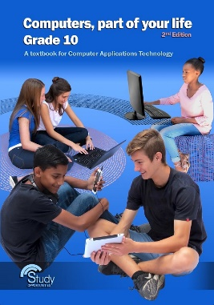
Module 1.7 Extended hardware concepts

Slide 2
Contents (1)
Input and output devices
Pointing devices
Sensors
Gaming devices
Digital cameras
Scanners and reading devices
Video and audio input
Audio output
Data projectors
Multi-function printers
Fax machines

Slide 3
Contents (2)
Storage devices and media
CD, DVD, Blu-ray
Memory cards
Taking care of a PC system
Processing – Motherboard
CPU
RAM and ROM
Test and improve
Module activity

Slide 4

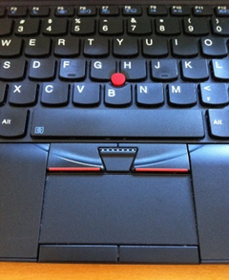
Input and output devices – Pointing devices
Mouse
Pointing stick: alternative to mouse
Touchpad: Pressure sensitive surface
Touchpad buttons

Slide 5
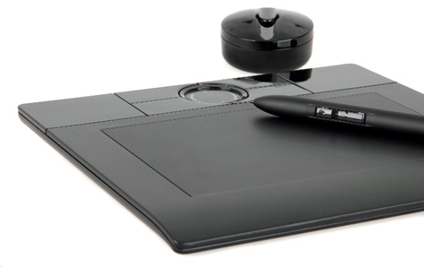
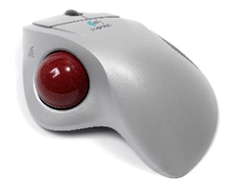
Input and output devices – Pointing devices
Pen input device: pen/stylus used with pressure-sensitive digitising tablet
Trackball: Large ball rolled by thumb

Slide 6
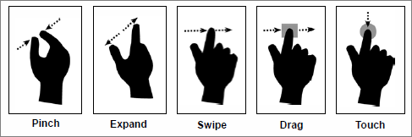

Input and output devices – Pointing devices
Touch screen
Gestures
Pinch – zoom out
Expand – zoom in
Twist two fingers – rotate
Swipe – scroll in the direction of swipe
Touch-and-drag – click-and-drag

Slide 7
Input and output devices – Sensors
Accelerometer
Detects movement
Changes orientation of screen
Temperature sensor
Safeguards electronics
Light sensor
Adjusts brightness of screen
Can switch off the screen
Acts as game controller
Switches device off when too hot
Electronic compass
Shows direction in which device is pointing

Slide 8
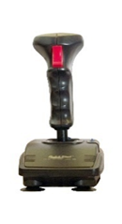
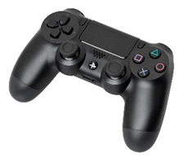
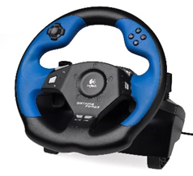
Input and output devices – Gaming devices
Joystick: oldest and simplest game controller
Game controller: 2 mini joysticks, 4 triggers, 8 other control buttons
Steering wheel

Slide 9
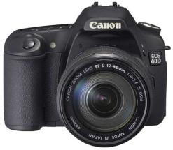
Input and output devices – Digital cameras
Pictures can be downloaded, manipulated, printed or emailed
Most smartphones include a good quality digital camera
Easy to share instantly, to edit and to back up
Resolution determines quality: the higher the resolution, the higher the quality (and size!)

Slide 10
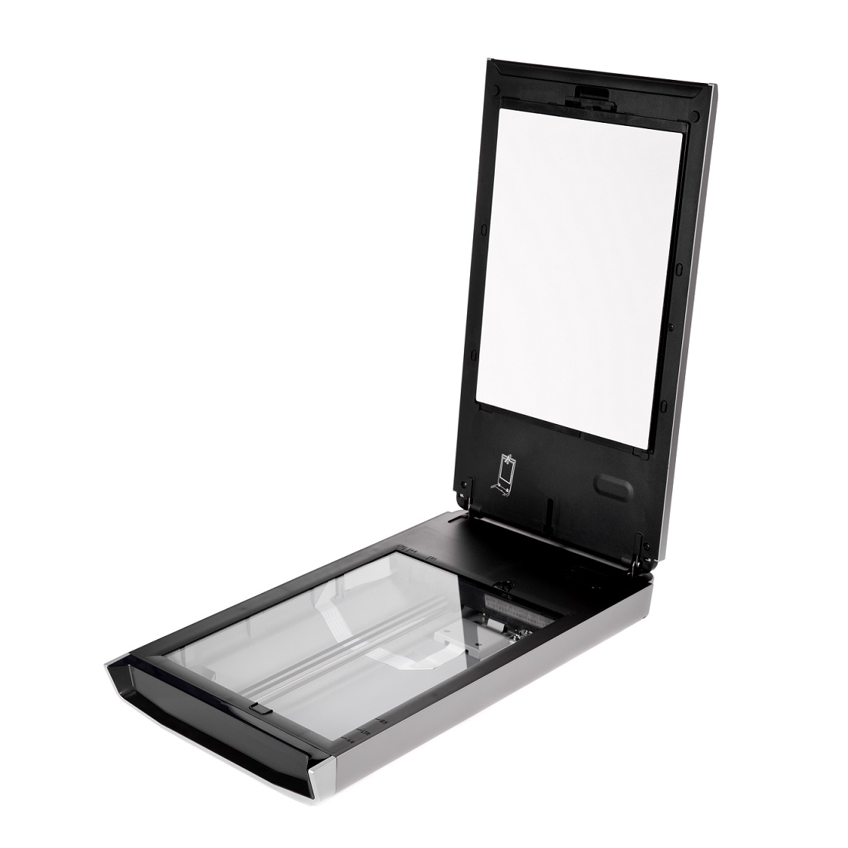
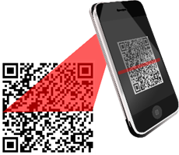
Input and output devices – Scanners / Reading devices
Flatbed and sheet-fed scanners
Scans images into a computer
Largely replaced by use of cameras on mobile devices
QR codes: quick access to web address

Slide 11
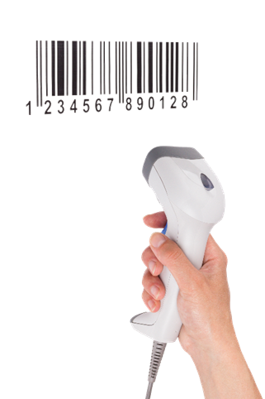
Input and output devices – Scanners / Reading devices
Barcode readers
Barcode scanned to access extra information about item:
Price
Codes on central database
Update records for stock taking / sales figures
Benefits: Speed + Accuracy

Slide 12
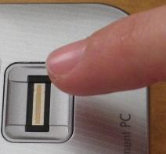
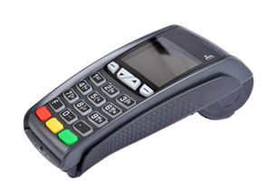
Input and output devices– Scanners / Reading devices
Biometric scanner: measures something biologically unique – fingerprint / iris
Card input: data stored magnetically

Slide 13

Input and output devices – Scanners / Reading devices
RFID (Radio Frequency Identification): small radio devices to store and transmit data
Character recognition
OMR: Optical Mark Recognition – scan and mark tests
MICR: Magnetic Ink Character Recognition – magnetic ink on cheques
OCR: Optical Character Recognition – scan and then edit text

Slide 14
MODULE Activity Page 78
Complete questions 1 – 12
14

Slide 15
Input and output devices – Video and audio input
Getting video onto the computer
record it directly from a webcam
transfer it from a digital camera or digital video camera
transfer it from a cell phone

Slide 16

Input and output devices – Video and audio input
Audio can be used for:
recording and mixing music
recording narration for presentations and videos
inputting text – you need voice recognition software
giving the computer commands

Slide 17

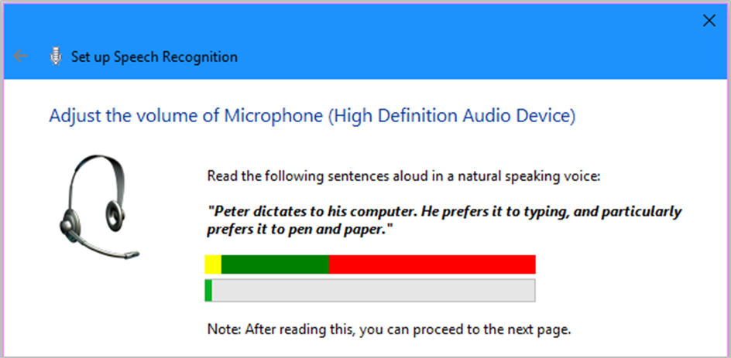
Input and output devices – Video and audio input
Voice recognition software
Use a microphone to give commands / dictate text
Windows – Speech Recognition

Slide 18
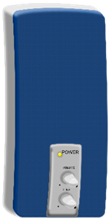
Input and output devices – Audio output
Sound is used to:
Give user feedback when interacting with computer
Make it easier for disabled people (text-to-speech)
Make games more realistic
Turn computers into real entertainment devices – play movies and music
Quality of the sound produced depends on the quality of the equipment

Slide 19
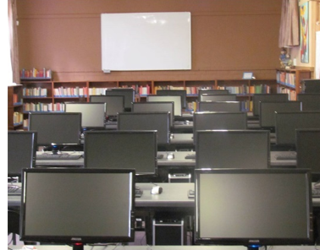
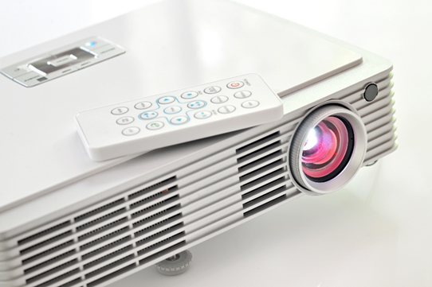
Input and output devices – Data projectors
Presentations to an audience
Displays what is on the monitor onto a screen or wall
LCD, DLP, RGB, LED, Pico

Slide 20
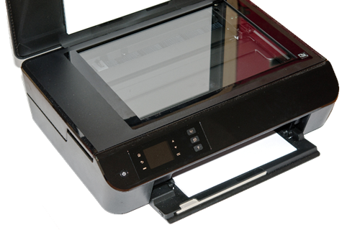
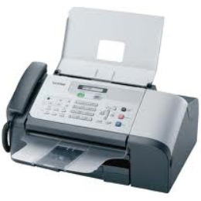
Input and output devices – Multi-function printers
A number of functions rolled into one:
printer
scanner (also scanning to PDF)
fax / email facility
photocopier
Fax machine
A stand-alone device – scans document and transmit image via a telephone line to another fax machine, also fax-to-email facility

Slide 21
MODULE Activity Page 78
Complete questions 13 – 18
21

Slide 22
Storage devices and media – CD, DVD, Blu-ray
CDs and DVDs – used to distribute software and music DVDs and Blu-rays – used to store movies
Optical drive – drive that uses laser light to read from or write to optical discs
Portable storage (flash drives / portable hard drives) are replacing optical media
Maximum capacity
CD | 700 MB
DVD | 8.5 GB
Blu-ray | 50 GB (or more)

Slide 23
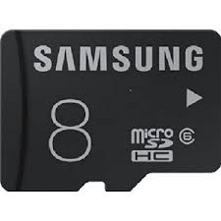
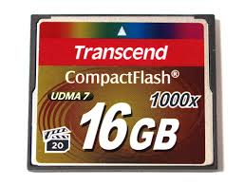
Storage devices and media – Memory cards
SD (Secure Digital)
Memory Stick
CompactFlash
How to use
Insert card into a card reader, which is connected to computer via USB port … can then treat like a flash drive to transfer files.

Slide 24
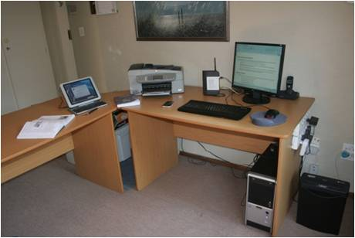
Taking care of a PC system
What you can do in your computer work area:
Keep magnetic sources away from computer
Keep dust free
Area well ventilated
Do not drink liquids near computer
Do not eat over keyboard

Slide 25
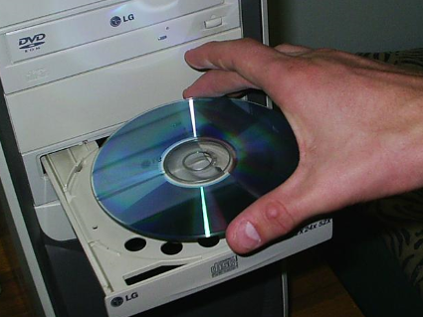
Taking care of a PC system
Optical storage media:
Protect from scratches – store in cases
Clean carefully, using clean water and soft cloth
Hold by the edges

Slide 26
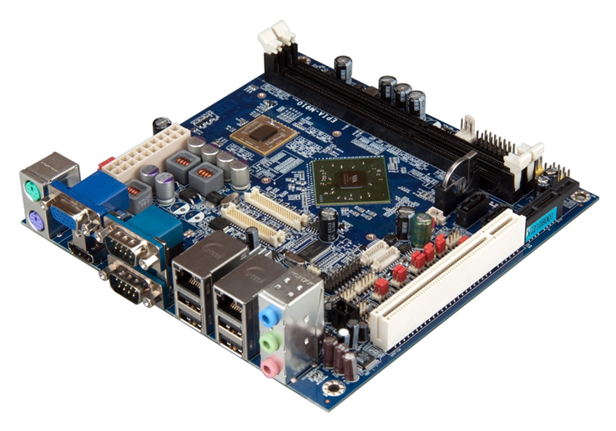
Processing – Motherboard

Slide 27
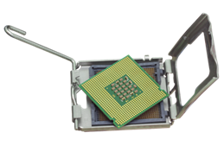
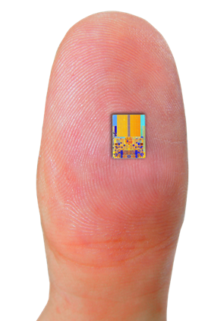
Processing – CPU
Central Processing Unit (processor)
CPU speed measured in gigahertz (GHz). Plugs into a socket on the motherboard.
Working part of CPU is a very small piece of silicon – contains billions of electronic circuits!

Slide 28
Processing – RAM and ROM
RAM: Random Access Memory
Where CPU keeps all the data / instructions it is working on
RAM is volatile
RAM is supplied in modules called DIMMs – fit into slots on motherboard
RAM is fast (it is electronic, and therefore much faster than storage).
RAM is expensive (costs more per GB than storage).
The more RAM – the better PC performance

Slide 29
Processing – RAM and ROM
ROM: Read Only Memory
Special chip that holds the instructions needed to start computer and load the operating system
Relatively small
Non-volatile (keeps its contents when power is off)

Slide 30
Test and improve
Input and Output Devices
Pointing devices
Storage devices and media
CD, DVD, Blu-ray
Processing
CPU
Sensors
Gaming devices
Digital cameras
Scanners and reading devices
Video and audio input
Audio output
Data projectors
Multi-function printers
Memory cards
RAM and ROM
Motherboard

Slide 31
MODULE Activity Page 78
Complete questions 19 – 22 and 23 – 36
31

